Slide 1
Dealing with complicated data in time series models
Eric Ward
Feb 16 2017

Slide 2
Missing data
Data may be missing (NAs) in response or predictors
Some models (functions) require complete datasets
Variety of interpolation methods

Slide 3
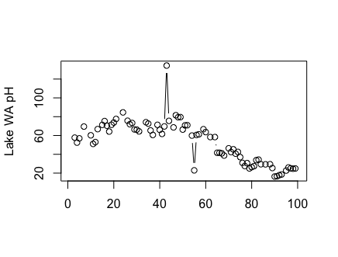
Example dataset
Lake WA pH

Slide 4
Simple approach
Linear interpolation
[3, NA, 4.3, 5.4, NA, 6.1]
2nd observation becomes (3+4.3)/2
5th observation becomes (5.4+6.1)/2
Trickier when more data is missing,
[NA, NA, NA, 5.4, NA, 6.1]

Slide 5
Linear interpolation for longer gaps
library(zoo)
na.approx() function
Example for our Lake WA data:
y_new = y
y_new[is.na(y)] = na.approx(y,na.rm=FALSE)[is.na(y)]
* Missing values filled in via linear interpolation

Slide 6
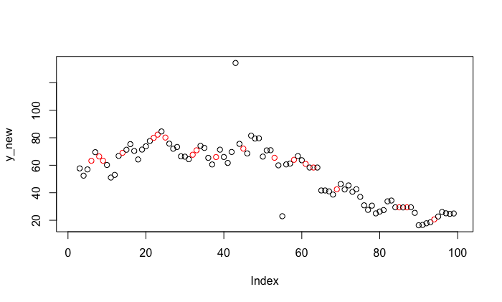
Imputed values in red

Slide 7
Two useful extensions
maxgap
na.approx(y,na.rm=FALSE, maxgap = 3)
rule (inherited from approx()): should data be extrapolated (2) or not (1)
na.approx(y,na.rm=FALSE, maxgap = 3, rule=2)
Data point closest is used for extrapolation

Slide 8
Alternative linear interpolation
Use rollmean() function in zoo library to customize the rolling window
rollmean(y, k=3, align = c("center", "left", "right"))

Slide 9
Alternatives to linear interpolation
Splines (think GAMs)
Fit the spline yourself
Or use other ‘na’ functions
na.locf() – last observation carried forward
na.spline() – interpolate with spline

Slide 10
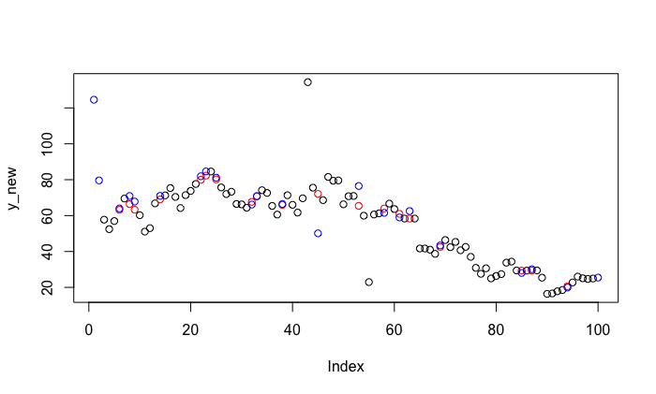
Spline(blue), linear (red)
Beware near end of time series / near lots of missing data
Notes:
y_new = y
y_new[is.na(y)] = na.approx(y,na.rm=FALSE)[is.na(y)]
plot(y_new, col = 1+as.numeric(is.na(y)))
y_new[is.na(y)] = na.spline(y,na.rm=FALSE)[is.na(y)]
points(which(is.na(y)), y_new[which(is.na(y))], col="blue")

Slide 11
Other interpolation approaches
imputeTS: wrapper for approx(), contains other splines
Splines:
smooth.spline()
gam (mcv)

Slide 12
Is interpolating a good idea?
One consequence is falsely increased precision
As example we can fit a univariate state space model (with MARSS) to the three datasets:
Raw (including missing values)
Interpolated (linear)
Interpolated (spline)

Slide 13
How do variances compare?
Linear interpolation = low observation error
Model | Q | R
Raw | 0.0161 | 0.0148
Linear interp | 0.01079 | 0.01389
Spline interp | 0.0161 | 0.0148
Notes:
y = lakeWAplanktonRaw[1:100,4]
y[sample(1:100, size=20, replace=F)] = NA
y_new = y
mod_1 = MARSS(log(y_new))
y_new[is.na(y)] = na.approx(y,na.rm=FALSE)[is.na(y)]
mod_2 = MARSS(log(y_new))
y_new[is.na(y)] = na.spline(y)[is.na(y)]
mod_3 = MARSS(log(y_new))

Slide 14
Missing covariates
Generally, missing covariates can be more of a problem (e.g. state space models, DFAs, etc)
Same approaches can be used for interpolation
Or in a Bayesian framework, the missing values can be assigned priors

Slide 15
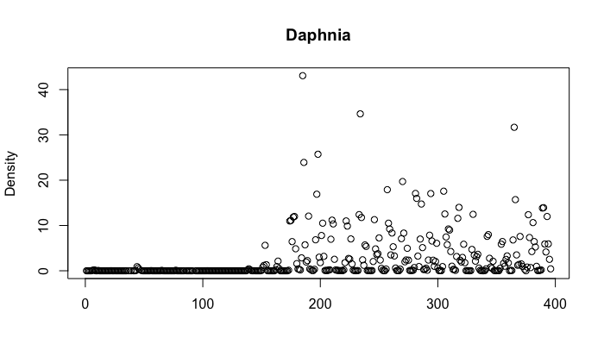
When missing data are zeros
Lake WA Daphnia
Notes:
plot(lakeWAplanktonRaw[,"Daphnia"], main="Daphnia", ylab="Density", xlab="")

Slide 16
Options
Throw out observations
Transform your data
Work with more complicated statistical models

Slide 17
Data transformations
Ln(y + small number) is one of the more common approaches
BUT choice of small number has impact on results
What is adding a constant going to do to observation or process variances?

Slide 18
Adding constants to Daphnia
Constant | R | Q | U
1 | 0.002973 | 0.462834 | 0.000901
0.1 | 0.00523 | 1.20592 | 0.00419
0.01 | 0.00881 | 2.03384 | 0.00954
0.001 | 0.0187 | 2.9671 | 0.0153
0.0001 | 0.0714 | 4.3777 | 0.0212
0.00001 | 0.7155 | 5.62 | 0.0275
Notes:
y = lakeWAplanktonRaw[,"Daphnia"]
mod_1 = MARSS(log(y + 1))
mod_2 = MARSS(log(y + 0.1))
mod_3 = MARSS(log(y + 0.01))
mod_4 = MARSS(log(y + 0.001))
mod_5 = MARSS(log(y + 0.0001))
mod_6 = MARSS(log(y + 0.00001))

Slide 20
Alternate statistical distributions
Use time series (MARSS) or other statistical model for positive values > 0
Apply logistic regression (or more complicated model) to model zeros

Slide 21
Delta-GLMs
Density of marine fishes almost always fits this pattern (zero inflated)

Slide 22
Delta-GLM or ‘hurdle models’
Breaks the response into 2 parts
Presence / absence
Positive density
2 separate GLMs
May include different covariates
If we include random effects / shared terms, they usually aren’t correlated across models
Different data + different link functions = weird interpretation
Results from both models combined for estimates of total density

Slide 23
Example with Daphnia
Example code for GLM
y_int = ifelse(y > 0, 1, 0)
mod = glm(y_int~seq(1,length(y_int)), family="binomial")
pred = predict(mod, newdata=data.frame(1:396), type="response", se.fit=T)

Slide 24
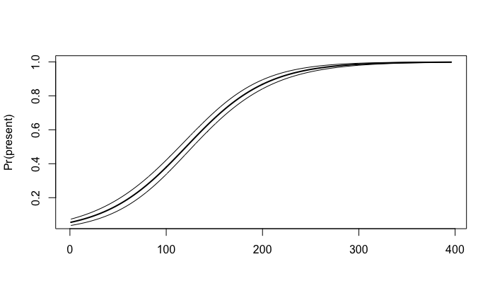
Probability of Daphnia
Notes:
plot(pred$fit, type="l", lwd=2, ylab="Pr(present)", xlab="")
lines(pred$fit+pred$se.fit)
lines(pred$fit-pred$se.fit)

Slide 25
Positive model
Convert 0s to NAs
y[which(y==0)]=NA
Fit MARSS model
mod = MARSS(log(y))
Predictions (log space)
exp(c(mod$states))

Slide 26
Estimating total density
Multiply Pr(present) * E[density|present]
Standard errors more complicated
Delta method
Monte Carlo simulation, etc

Slide 27
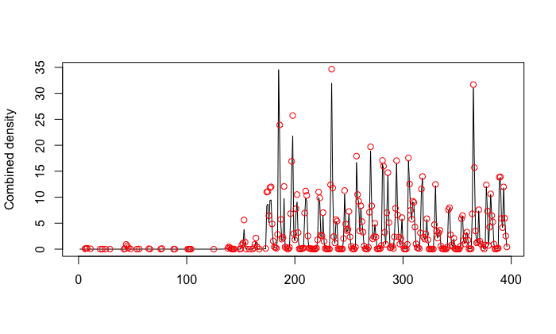
Combined model: E(present) * E(pos|present)

Slide 28
Other types of response data may be non normal

Slide 29
We can model the response as function of predictors using link functions
Defaults in GLMs
Binomial data (logit link)
Poisson, Negative Binomial, Gamma, Lognormal (log link)
Note that these formulas don’t include additional error (like regression)

Slide 30
GLMMs
Including additional variation turns GLMs -> GLMMs
More data hungry, but flexible
Random effects allow us to turn ordinary GLMMs into time series models or models with spatial effects

Slide 31
Where have we seen this before?
We could construct a DLM with binomial response (or any other distribution)

Slide 32
Univariate -> multivariate
For population i
As in MARSS models, we need to think about how to model the deviations
Independent and shared variance across pops?
Independent and unique variance across pops?
“equalvarcov”
Unconstrained
Model covariance as spatially correlated

Slide 33
Powerful functions for estimating non-normal response data
rstanarm
Extension of Bayesian regression, GLMs, GLMMs, etc
glmmTMB (or lme4, bbmle, etc)
Fast maximum likelihood estimation
Same formula syntax as glm(), lm(), etc

Slide 34
BUT
These approaches don’t incorporate time series aspect of our data
Other packages: tscount, etc
And can be included in our function fit_stan()

Slide 35
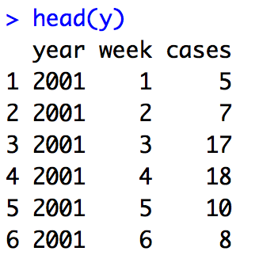
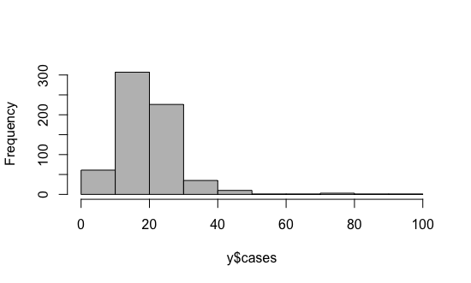
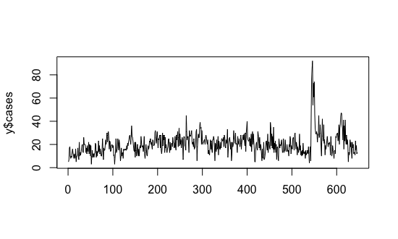
Example: time series of ecoli
y = tscount::ecoli

Slide 36
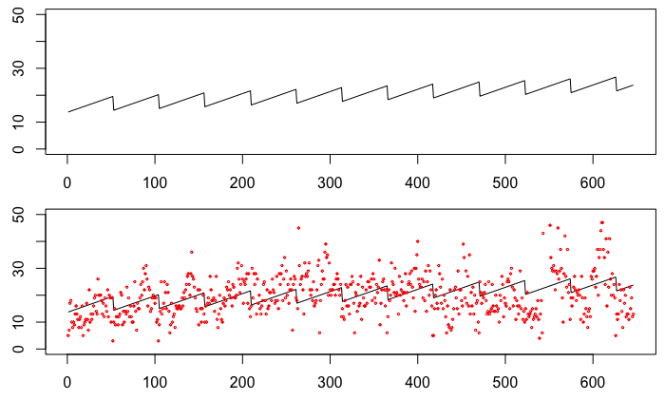
glmmTMB
glmmTMB(cases ~ week + year, data=y, family=“poisson”)

Slide 37
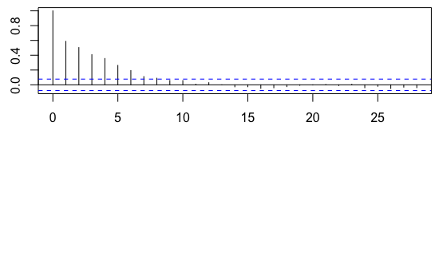
But residuals show problem
Not independent, ACF shows they’re very correlated

Slide 38
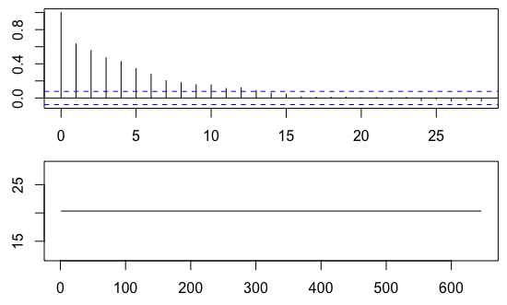
tscount()
mod = tsglm(y, link="log", distr="poisson")

Slide 39
Added complexity
Observations at time t can be made a function of predictions or observations in previous time steps
model = list(past_obs = NULL, past_mean = NULL,…)
Size of moving window also flexible
Covariates can be included: time or external predictors

Slide 40
Implementation in stan
fit_stan has a 'family' argument which can be specifed as
“gaussian”
“binomial”
“poisson”
“gamma”
“lognormal”
“negative-binomial”
Etc
Only for the following models: Regression, DLMs, 'MARSS’ models

Slide 41
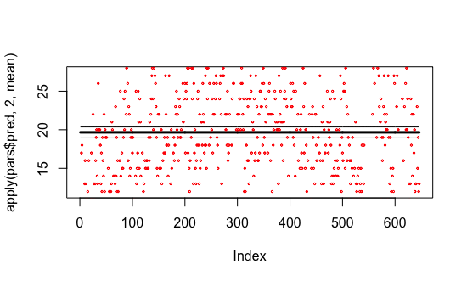
Poisson regression
mod = fit_stan(y, x = model.matrix(lm(y~1)), model="regression", family="poisson")
Notes:
mod = fit_stan(y, x = model.matrix(lm(y~1)), model="regression", family="poisson")
plot(apply(pars$pred, 2, mean), type="l", lwd=3)
lines(apply(pars$pred, 2, quantile,0.025))
lines(apply(pars$pred, 2, quantile, 0.975))
points(y, col="red",cex=0.3)

Slide 42
Implementation of DLM
We’ll fit model with time-varying level (mean)
- No covariates included
mod = fit_stan(y, model="dlm-intercept", family="poisson")

Slide 43
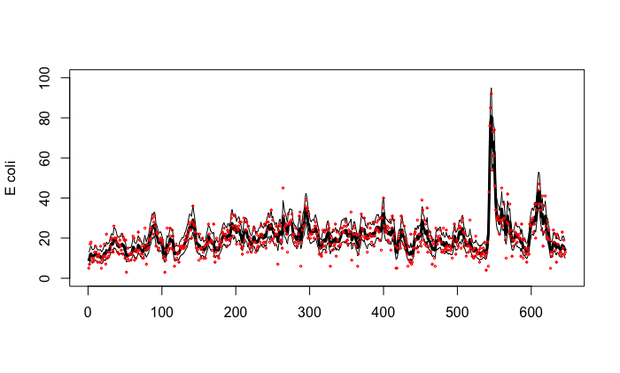
Now capturing data much better!
Notes:
mod = fit_stan(y, model="dlm-intercept", family="poisson")
plot(apply(exp(pars$intercept), 2, mean), type="l", lwd=3, ylim=c(0,100), ylab="E coli", xlab="")
lines(apply(exp(pars$intercept), 2, quantile,0.025))
lines(apply(exp(pars$intercept), 2, quantile,0.975))
points(y, col="red", cex=0.3)

Slide 44
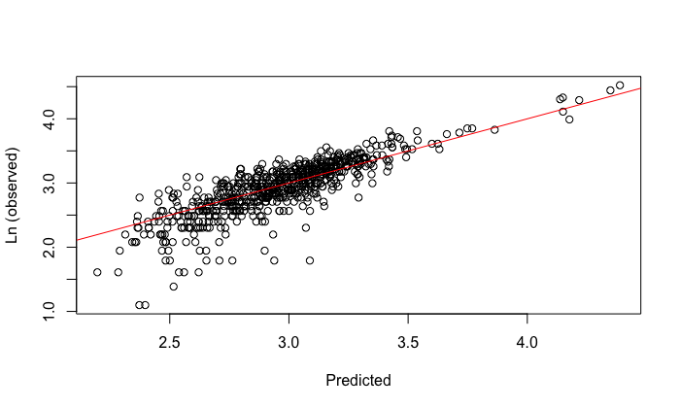
Predicted vs observed

Slide 45
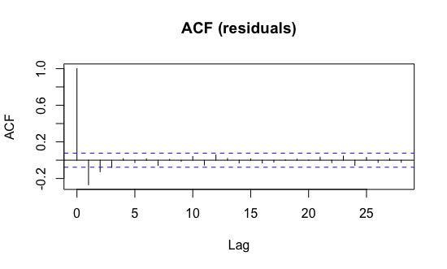
Residuals look much better
Still negative acf ~ lags 1-2
Notes:
mod = fit_stan(y, model="dlm-intercept", family="poisson")
plot(apply(exp(pars$intercept), 2, mean), type="l", lwd=3, ylim=c(0,100), ylab="E coli", xlab="")
lines(apply(exp(pars$intercept), 2, quantile,0.025))
lines(apply(exp(pars$intercept), 2, quantile,0.975))
points(y, col="red", cex=0.3)

